Slide 1
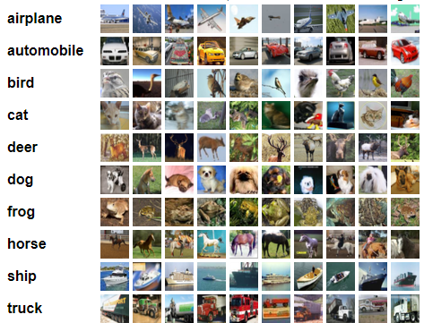
Project outline :
Research Federated learning field ( problems, current algorithms and their limitations … )
Implement a centralized experiment as an upper bound and implement the baseline using the traditional FedAvg algorithm
Modify the algorithm parameters to study how training and accuracy changes.
Check and implement different algorithms and compare them
Add Batch normalization layers and study their influence.
Try a new technique/algorithm/solution
The Task was image classification in federated learning scenario and the dataset used was CIAFR-10 for all experiments.
The data were distributed to all clients in different IID/non IID conditions
CIAFR-10 dataset [1]
[1] https://www.cs.toronto.edu/~kriz/learning-features-2009-TR.pdf

Slide 2
Implementation details:
LeNet-5 architecture was used as the backbone
The centralized experiment was used to tune the learning rate and as an upper bound
In the centralized experiment the model was trained for 120 epochs with an unchanged learning rate of 0.1 and the resulting accuracy is 50%
The baseline (FedAvg) was implemented with 20 total number of clients all with same number of samples, local epoch= 1, fraction of chosen clients each round= 0.2, and synchronous updating scheme
LeNet-5 architecture
Input
3x32x32
Conv1
Flatten
Output
10
Maxpool
Conv2
Maxpool
Conv3
Fully connected

Slide 3
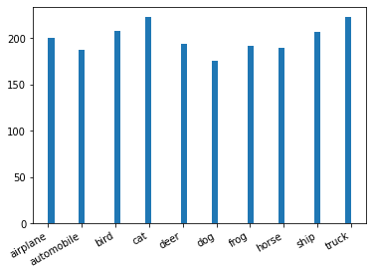
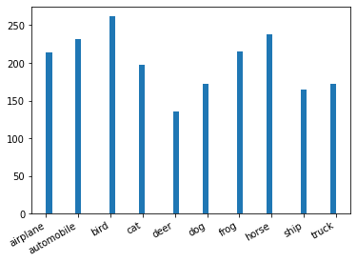
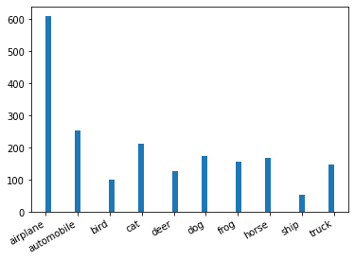
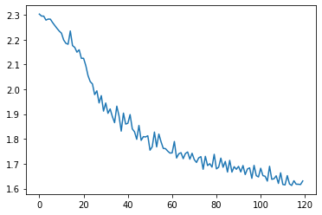
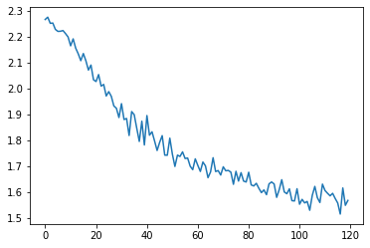
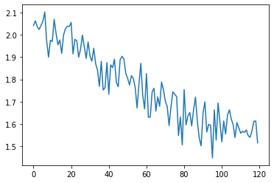
Alpha= 1000
Alpha= 100
Alpha= 10
Number of samples
per class
Training Loss

Slide 4
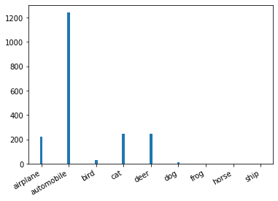
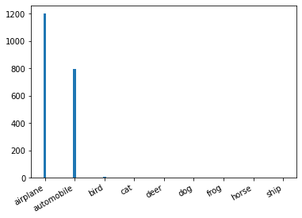
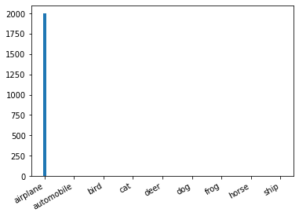
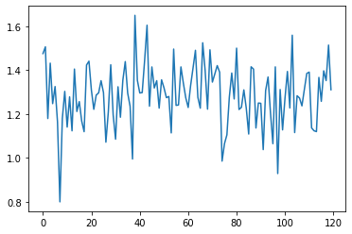
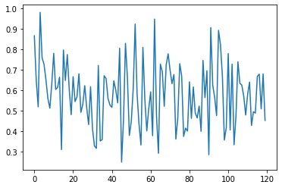
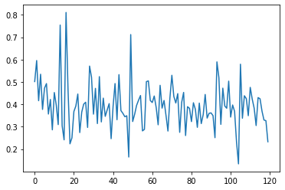

Alpha= 1
Alpha= 0.1
Alpha= 0.01
Number of samples
per class

Slide 5
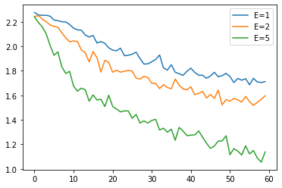
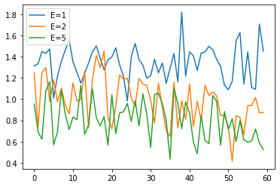
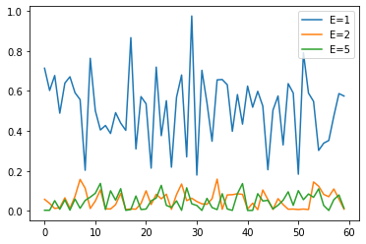
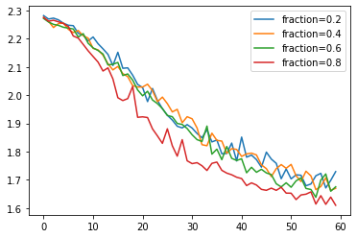
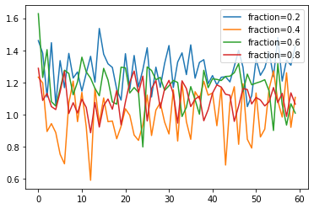
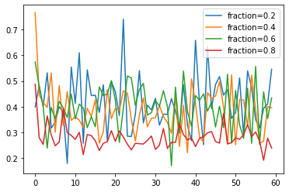
Alpha= 100
Alpha= 1
Alpha= 0.01
Training loss
Changing local epoch
Training loss
Changing fraction of clients per round

Slide 6
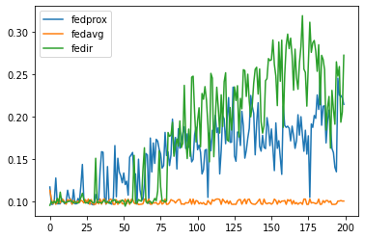
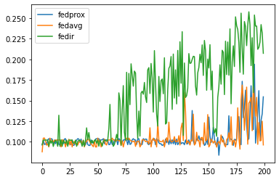
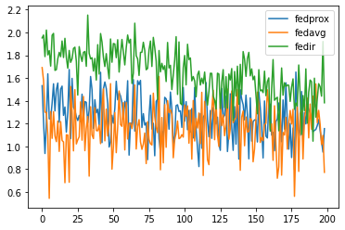
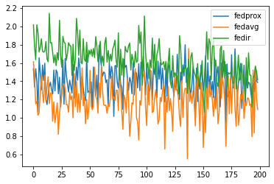
Experiment 1
Experiment 2
Validation Accuracy
Training Loss

Slide 7
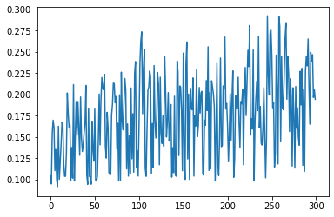
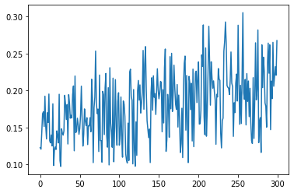
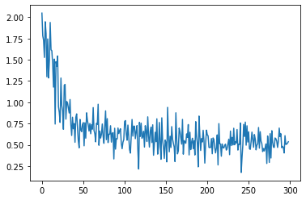
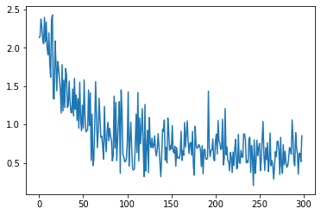
FedAvg Batch-normalized LeNet, alpha=0.1
FedIR Batch-normalized LeNet, alpha=0.1
Validation Accuracy
Training Loss

Slide 8
Proposed solution
Since we try to minimize the global loss function by minimizing the clients' local losses, the heterogeneity of our clients’ data make the expected value of client local loses diverge from the global one.
Clients with a few classes’ sample tends to have overconfidence in their prediction and allocate the whole feature space to these classes.
Our proposed solution exploit some open set problem solutions for our heterogeneity issue as follow:
openSet classification model
will account for unknown sample
through an unknown class using
Some regularization term/ technique
During training to prevent the
Overconfident scores and to
account of possible unknown samples
unknown
classification model will partition the
feature space among classes

Slide 9
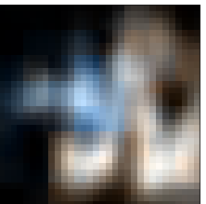
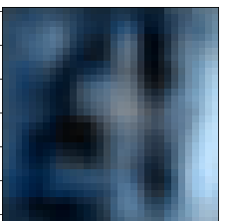
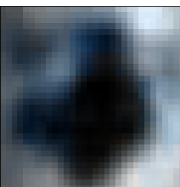
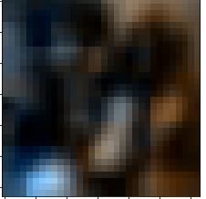
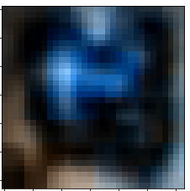
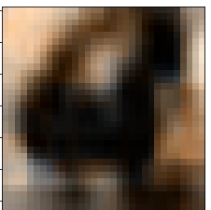
we think of our solution as telling the local models that there might be other classes in the data of other clients, To apply this, we need :
a model to generate unknown/ random samples inside the client devices.
Extension of the model output during training so it have the unknown class output and trim this output after training.
The unknown sample don’t need to be meaningful images but at the same time they should have some geometric shape and not completely random, otherwise, the feature extraction with convolution layers may be harmed
For generating unknown sample
we tried 2 ways:
Low cost and fast :alter heavily some
Samples and label them unknown.
Slower with higher cost: Train an
autoencoder to generate low Quality
random images.
We call our proposed algorithm “FedExt”
The images on the right are samples generated
With the 2nd method

Slide 10
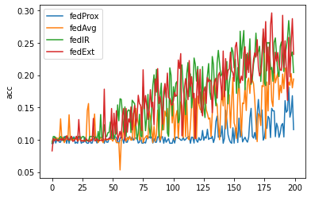
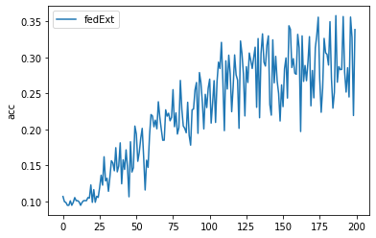
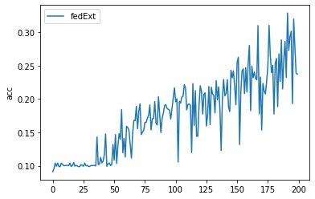
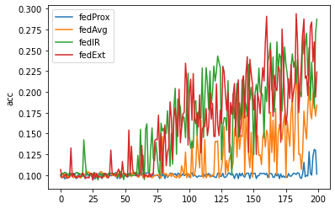
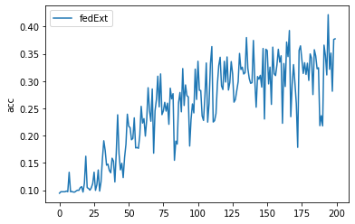
FedExt with unknown sample
generated with method 1
FedExt with unknown sample
generated with method 2
Wr=0.8, fr=0.6
Wr=0.8, fr=0.2
Wr=0.8, fr=0.4

